Slide 1
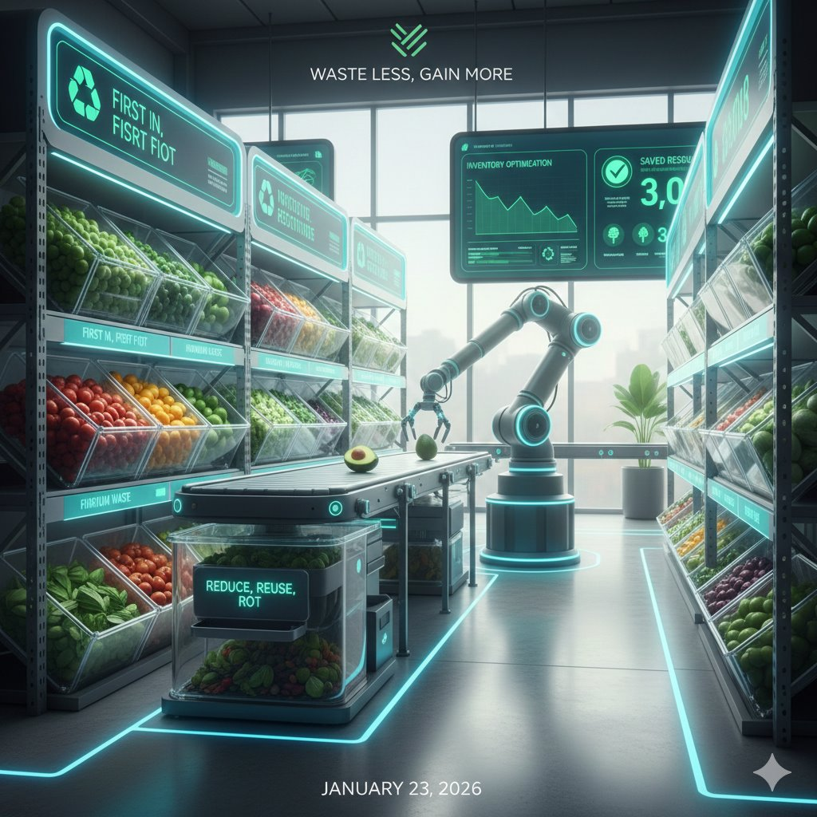

SmartCart AI:A Decision-Centric Agentic System for Inventory Waste Reduction and Pricing Optimization
Megha Narendra Simha
Advisor: Sivakumar Visweswaran
Week 5
Winter 2026
MSCS

Slide 2
Agenda
Future Work
Approach
System Architecture
ER Diagram
Use Case Diagram
UI Flow & Design
API Design
Annotated Bibliography
Key References
Motivation
Problem Statement
Background
Related Work
Synthesis Matrix/Feature List

Slide 3

Motivation
Food and product waste remains high as retail AI systems focus on demand prediction rather than real-time intervention.
This results in up to $540B in global losses, with nearly one-third of food retail revenue wasted and limited waste visibility (Aylak, 2025; Avery Dennison, n.d.).
Current systems rarely apply dynamic pricing, discounting, or bundling for perishable goods.
The lack of adaptive mechanisms limits both waste reduction and revenue optimization (Zhou et al., 2024).
Notes:
Gained hands-on experience with a hospital inventory management system; observed how delayed/manual decisions caused resource waste.
Realized similar issues exist at a much larger scale in e-commerce inventory, especially for perishable products.
Interested in building AI agents that reason, collaborate, and make decisions, not just predict outcomes.
Most AI systems are prediction-oriented; real-time, autonomous decision-making is lacking in retail supply chains (Aylak, 2025).
This gap inspired the development of SmartCart AI.
Targets: E-commerce retailers and inventory owners managing perishable/high-turnover goods.
Also applicable to large tech companies and global enterprises (e.g., Amazon, Walmart, Costco) needing autonomous, real-time decision-making to reduce waste, improve efficiency, and enhance sustainability.

Slide 4
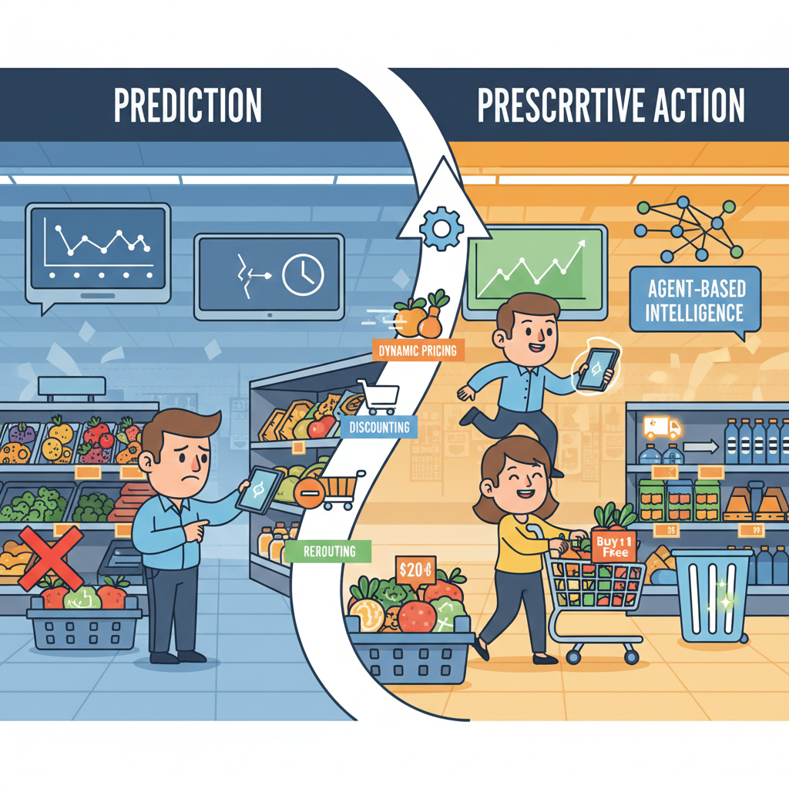
Problem Statement
How can AI inventory systems shift from prediction to real-time, prescriptive action?
How can dynamic pricing, discounting, bundling, and rerouting respond to inventory risk?
How can real-time interventions reduce waste while maximizing revenue?
How can agent-based intelligence unify forecasting, cost, and execution for end-to-end optimization?
(Ankam, 2025; Bharti, 2025; Bhavikatta, 2025; Samuels, 2025)
Notes:
Food and product waste remain major challenges in retail and e-commerce supply chains, particularly for perishable and high-turnover inventory.
While AI is widely used today, most existing systems are focused on demand prediction, not decision-making.
Studies by Ankam (2025), Bharti (2025), and Bhavikatta (2025) show that current AI tools can forecast demand accurately, but fail to prescribe operational actions when inventory is at risk of expiring or becoming obsolete.
As a result, inventory managers still rely on manual decisions or static rules, which slows response time and often leads to unnecessary spoilage and overstock.
These systems also lack real-time adaptability, making them ineffective during sudden demand changes or logistics disruptions.
As emphasized by Samuels (2025), achieving sustainability in retail requires AI systems that move beyond prediction to autonomous, waste-aware intervention.
This leads to the central problem: How can AI-driven inventory systems move from forecasting demand to prescribing real-time operational actions that actively reduce waste?

Slide 5
Background
Shift from EDOQ / JIT to AI-driven inventory models
Uses ML, LSTM, RL, and model-agnostic signals
Handles 50–100 variables (weather, social media, pricing)
Reduces predictive error to 10–15%; accuracy up to 98%
Benefits: lower costs, higher revenue, reduced safety stock
Implementation challenges: data quality, legacy integration, change management

Slide 6
Related Work
AI improves inventory effectiveness via forecasting, optimization, and risk estimation
Prior work mostly predictive, relying on historical data
Bharti (2025): ML for forecast & operational efficiency
Ankam (2025): Analytics + rule-based automation for visibility
Bhavikatta (2025): Highlights lack of prescriptive actions
Gap: Detection exists, but real-time interventions are missing

Slide 7
Synthesis Matrix
Criteria | (Bharti, 2025) | (Ankam, 2025) | (Bhavikatta, 2025) | SmartCart AI
Primary Focus | AI-driven retail inventory optimization | AI-based demand forecasting | Survey of AI methods for stockout and overstock mitigation | Waste-aware autonomous inventory intervention
Core AI Paradigm | Predictive analytics and optimization models | Forecasting models using historical data | Predictive and analytical review | Agentic, decision-centric AI
Decision-Making Capability | Rule-based or manual post-analysis | Not addressed | Identifies lack of prescriptive actions | Lightweight statistical forecasting (exponential smoothing / moving average/ETS) for short-term demand estimation, combined with model-agnostic LLM-based agentic decision orchestration and explanation via MCP
AI Agents | No | No | No | Yes
Manual Intervention Required | Yes | Yes | NA | No
Sustainability Emphisis | Secondary | Minimal | Conceptual | Primary
Model / Algorithm Used | Traditional ML (regression, boosting), optimization | Rule-based + classical forecasting (ARIMA, moving averages) | Statistical & ML methods (regression, ensembles) | Model-agnostic forecasting via MCP + LLM for decision orchestration and explanation
Price Optimization Capability | Limited / Not addressed | Minimal / Not addressed | Not addressed | Autonomous price and promotion recommendations integrated with inventory decisions

Slide 8
Feature List
Feature | What it does | AI/ML
Demand Forecasting | Predicts short-term item demand | ML: Moving average (SMA), Exponential smoothing (EMA), ETS (Holt–Winters; α, β, γ)
Inventory Monitoring | Tracks stock and consumption, flags items needing attention | Inventory Agent (rules + ETS/forecasting); LLM in Chat for Q&A only
Decision Making | Decides what actions to take (reorder, hold, discount, bundle) | Decision Orchestrator + sub-agents (Risk, Feasibility, Cost, Explanation); Mistral LLM in Orchestrator (synthesis) and Explanation sub-agent
Pricing & Promotions | Suggests reorder cost; suggests discount %, sell-at price, bundle | Cost Impact sub-agent: reorder cost/budget; Orchestrator (LLM): discount %, price, bundle (e.g. waste/expiry)
Explainability | Shows why decisions were made | RAG (PostgreSQL + embeddings) for evidence; Explanation sub-agent (Mistral) for narrative
System Modularity | Easy to swap models or agents | Fast MCP for plug-and-play agents

Slide 9
Future Work
Multi-Agent Reinforcement Learning (MARL) Enable self-learning agents to jointly optimize pricing and inventory decisions
Advanced Intervention Strategies Add agents for automated liquidation, redistribution, and exception handling
Cross-Facility Optimization Enable intelligent inventory transfer and balancing across multiple stores or warehouses
Enhanced External Signal Integration Incorporate weather, social media, and competitor pricing for improved prediction accuracy
Improved Explainability and Trust Provide transparent, natural language explanations for AI-driven decisions
Edge and IoT Integration Use IoT sensors for real-time shelf-life, storage, and waste-risk monitoring
Cross-Industry Expansion Adapt system to healthcare, pharmaceuticals, and other perishable inventory sectors

Slide 10
Approach
Agent-based system transforming inventory management from predictive analytics to prescriptive, automated decision-making
Inventory Monitoring Agent continuously detects risks (spoilage, low sell-through, excess stock)
Intervention Orchestration Agent analyzes risk signals and activates specialized decision agents
Decision Sub-Agents handle pricing optimization, promotions, redistribution, and waste reduction
Modular, event-driven architecture integrates with existing inventory systems in real time
Quantitative Component
Uses structured data: inventory levels, shelf-life, sales, sell-through
Applies statistical forecasting (Exponential Smoothing / ETS)
Enables measurable, objective risk detection and decision optimization
Qualitative Component
Agents apply contextual reasoning based on business rules and constraints
Generates interpretable, actionable recommendations (pricing, redistribution, intervention)
Combines data-driven analysis with intelligent, explainable decision logic

Slide 11
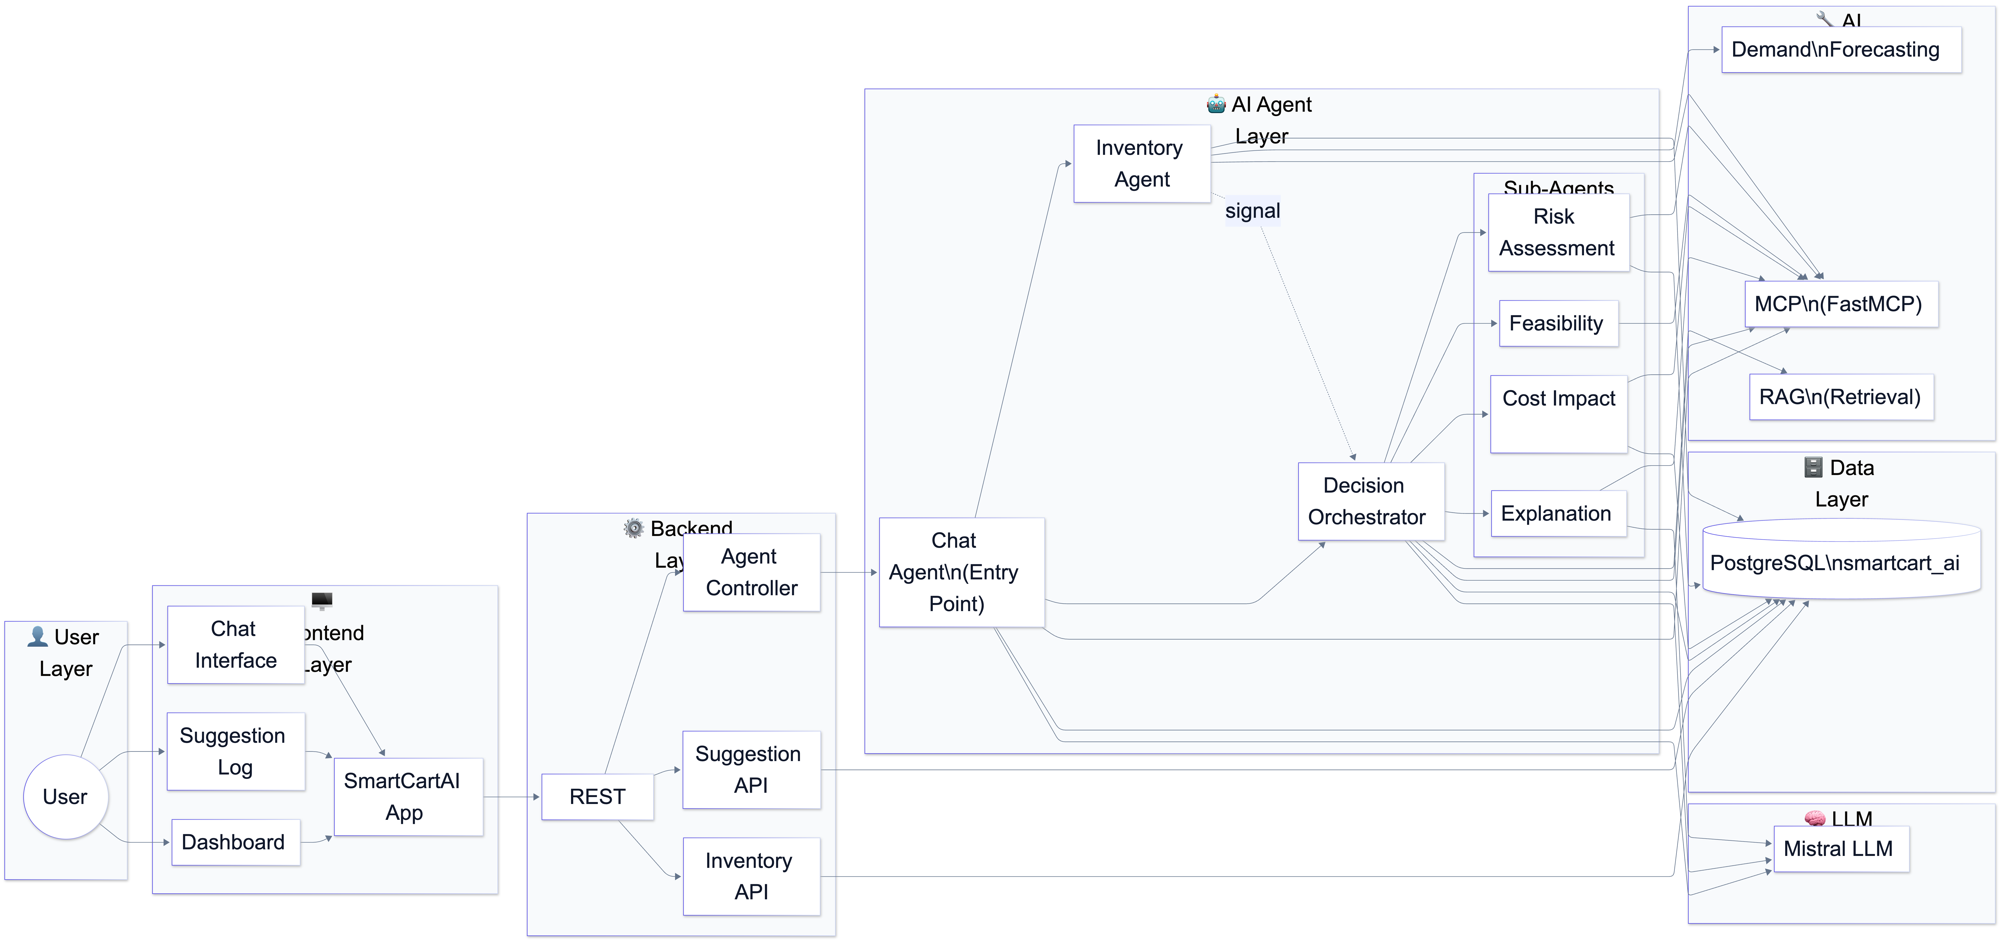
Layered System Architecture

Slide 12
Layered System Architecture
SmartCart AI – whole systemFront-end: Manager dashboard, simulation, chatbot → calls Java backend (inventory, sales, demand, suggestions, agent chat).
Java (Maven): REST API → CRUD + proxy to Python agents (chat, orchestrate, inventory signal).
Agent layer: Chat (entry) → Inventory (query + demand forecast) → Decision Orchestrator → sub-agents (Risk, Feasibility, Cost, Explanation). Uses Fast MCP, Mistral LLM, RAG (PostgreSQL).
Demand forecasting: ETS (Holt–Winters) with 3 parameters: α (level), β (trend), γ (seasonal); also exponential smoothing and moving average. Parameters via env (ETS_ALPHA, ETS_BETA, ETS_GAMMA); input from PostgreSQL consumption.
Data: PostgreSQL (inventory, sales, consumption, demand, suggestions); optional vector/RAG for similar-item retrieval in orchestrator. LLM and MCP use DB for context and to store results.
Flow: User → Front-end → Java → Agents (forecast, MCP, LLM, RAG) → DB → results back to agents → Java → Front-end (dashboard, chatbot, suggestion log, simulation).

Slide 13
Data Analysis
Database Load and Usage
CSV files loaded into PostgreSQL using COPY / \copy
Load order: Inventory → Sales → Consumption (FK dependency)
Database supports backend services and AI agents for:
Cost analysis
Demand forecasting
Inventory decision intelligence
Source Datasets (Kaggle)
Grocery Inventory and Sales Dataset (Salahuddin Ahmed Shuvo) → Product catalog, vendors, transactions, stock, and sales structure
Retail Store Inventory Forecasting Dataset (Anirudh Chauhan) → Time-series inventory, demand patterns, and forecasting reference
Data Synthesis and Alignment
Kaggle data used as reference to generate schema-aligned dataset
Standardized scope: ~50 products, 1-year timeline
Generated entities:
Inventory: products, categories, stock levels, vendors
Sales: invoices, quantities, costs, purchase records
Consumption: usage, spoilage, remaining stock

Slide 14
ER DIAGRAM
Inventory – Master table: inventory_id, item details, thresholds, selling_price, optional embedding for RAG/similar items.
Transactions – sales and consumption link to inventory_id; record sales and internal usage for forecasting inputs.
Demand – Stores forecasts: inventory_id, predicted_demand, model_version, prediction_date (e.g. ETS output).
Suggestions – AI recommendations: inventory_id, user_query, action, reasoning, forecasted_demand, risk/cost/explanation, status.
Flow – Inventory → sales/consumption → demand (forecast) → suggestions (agent output); all key tables reference inventory

Slide 15
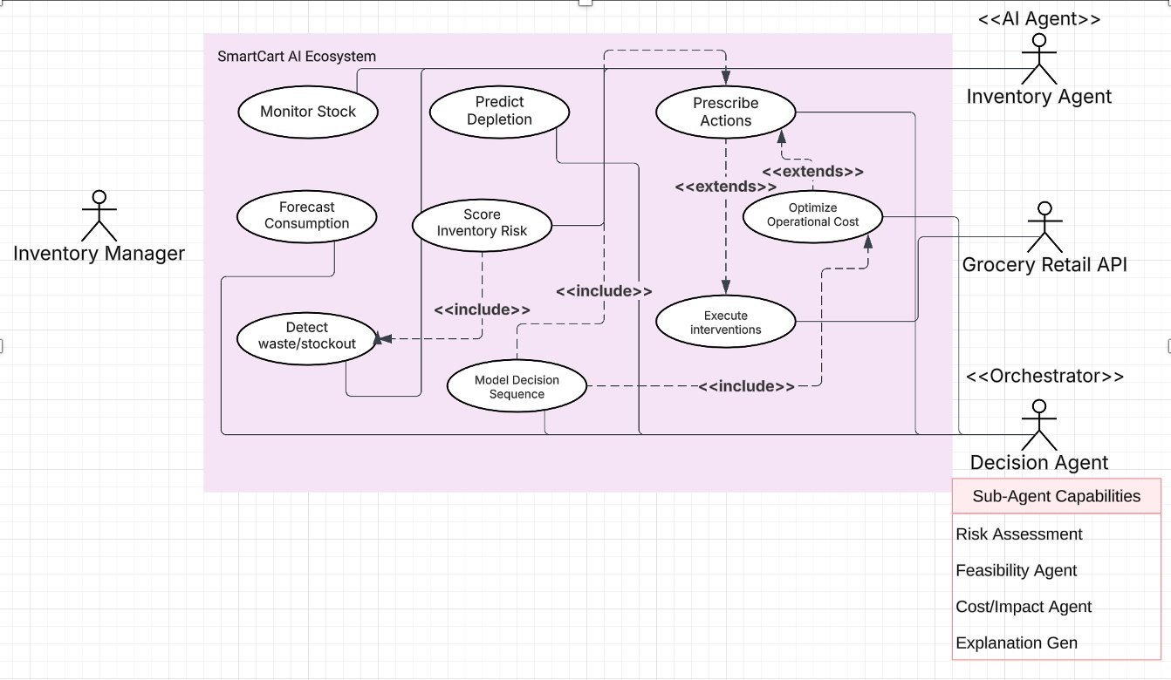
Use Case Diagram
Primary Actors: Connects the Inventory Manager (human) with specialized AI Agents and external Retail APIs.
Intelligence Layer: Uses AI to Predict Depletion and Forecast Consumption rather than just tracking current levels.
Autonomous Decision-Making:
Model Decision Sequence: Orchestrates the logic for interventions.
Prescribe Actions: Suggests solutions, with optional Cost Optimization triggers.
Operational Execution: Seamlessly bridges data insights to real-world actions via the Execute Interventions flow.
Sub-Agent Capabilities: Enhances decisions through specialized logic for Risk, Feasibility, Cost, and Explanations.

Slide 16
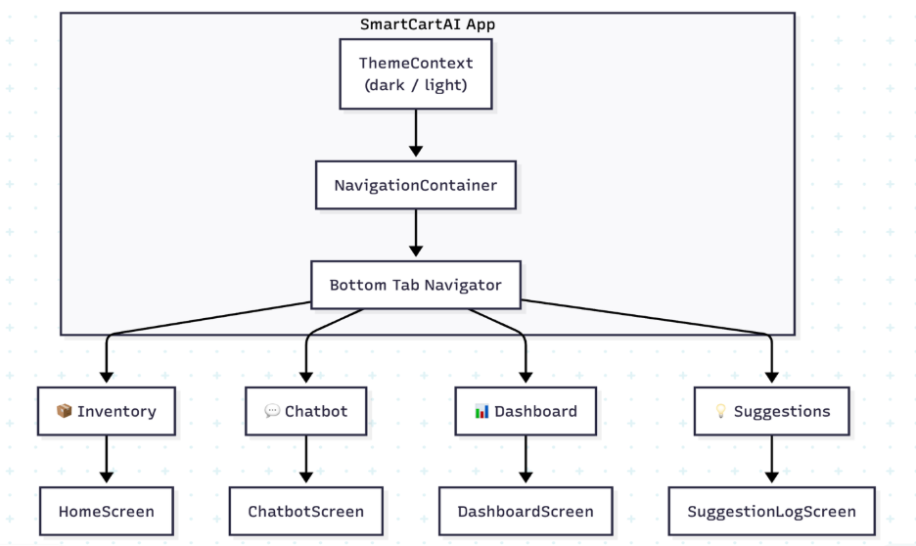
UI Flow

Slide 17
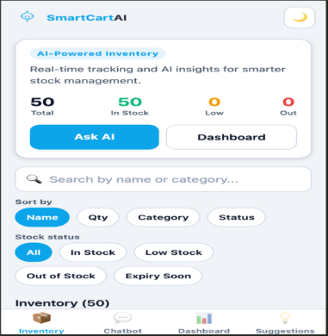
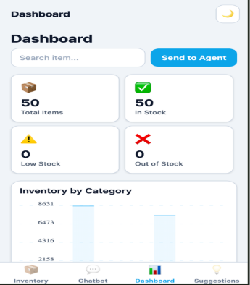
UI Pages

Slide 18
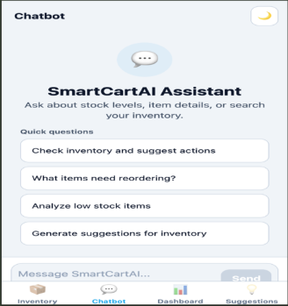
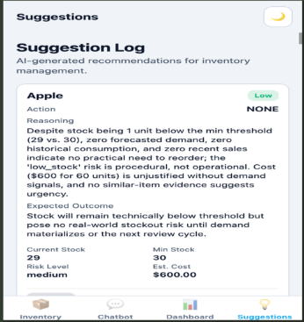
UI Pages

Slide 19
API DESIGN
Spring Boot 3.2 (Java 17) backend with REST APIs and PostgreSQL (Spring Data JPA)
Manages inventory, sales, demand, consumption, and AI suggestions
REST Controllers (/api/*)
Provide inventory, sales, demand, and suggestion endpoints
Suggestion API supports view, filter, and status updates
Documented using Swagger/OpenAPI
Agent Proxy (/api/agents)
Uses RestTemplate to communicate with Python agents
Supports inventory signals, decision orchestration, and chat
Agent URLs configured via environment variables
Data Layer
JPA entities map to PostgreSQL tables
Repositories provide CRUD and custom queries
Stores and retrieves AI-generated suggestions
Configuration
CORS enabled for frontend access
OpenAPI for documentation
Controllers directly connect to database and agents

Slide 20
Descriptive Statistics
Cost-Impact Subagent
Mean (AVG): Calculates average unit cost from recent sales
Used to estimate reorder cost and compute profit margin %
Demand Forecast & Decision Agents
Sum & Mean: 7-day consumption summed and averaged → daily demand rate
Counts & Totals: COUNT and SUM used for total items, total stock, and low-stock detection
Supports reorder decisions and cost analysis
Inventory Forecasting Agent
Moving Average: Mean of recent demand (short-term forecast)
Exponential Smoothing & Holt-Winters (ETS): Weighted averages capture trend and seasonality
Min/Max Logic: Uses min_stock, max_capacity, and current stock to detect low stock and overstock
UI and Dashboard
Displays statistical summaries: total stock, low-stock items, thresholds
Uses ratios and aggregates to show inventory health and recommendations

Slide 21
Annotated Bibliography
Bharti, M. (2025). AI-Driven Retail Optimization: A technical analysis of modern inventory management. International Journal of Advances in Engineering and Management, 7(2), 31–38. https://doi.org/10.35629/5252-07023138
This paper talks about the use of AI and machine-learning to optimize retail inventory issues with respect to better demand forecasting, replenishment planning, and operational efficiency is a subject of analysis in the current paper. It emphasizes predictive analytics and suggestion-driven models of forecasting and inventory optimization but does not deal with real-time implementation or autonomy of decisions. Although it does give a solid theoretical basis to AI-based inventory forecasting, it has little discussion about real-time interventions, waste minimisation or dynamic price optimization as a response to the inventory risk and the market environment. Bharti (2025) then places AI in a predictive tool mainly. SmartCart AI, in its turn, builds on this base by moving beyond predictive and prescriptive decision-making in favor of real-time decision-making. SmartCart AI can predict inventory risk and respond to operational changes, through agentic intelligence, that dynamically optimizes prices depending on inventory positioning, cost structures and, therefore, waste can be minimized and profits maximized.

Slide 22
Annotated Bibliography
Ankam, S. (2025). AI-Driven Demand Forecasting in Enterprise Retail Systems: Leveraging predictive analytics for enhanced supply chain. International Journal on Science and Technology, 16(1). https://doi.org/10.71097/ijsat.v16.i1.2644
This work provides a technical discussion of AI-based retail optimization systems, which focus on machine learning-based models and data-driven analytics to enhance inventory visibility, predictive accuracy, and operational efficiency. It examines how predictive models and rule-based automation might be used to aid in demand forecasting, inventory management, and replenishment planning, both in terms of analytical rigor and systematic operations. Nonetheless, it does not have inventory prioritization and risk-based action planning, but rather it depends on the fixed set of rules and preprogrammed automation which restricts its dynamical flexibility and autonomous decision-making in response to real-time inventory risks. The book offers a good technical base of AI-based optimization in retail especially in system architecture and data monitoring (Ankam 2025). Conversely, SmartCart AI closes the observation-intervention discrepancy by proposing agentic systems that are based on reasoning and convert analytical knowledge into real-time, context-sensitive, risk-sensitive inventory responses.

Slide 23
Annotated Bibliography
Bhavikatta, N. B. (2025). AI-Driven Inventory Optimization in Supply Chains: A comprehensive review on reducing stockouts and mitigating overstock risks. Journal of Computer Science and Technology Studies, 7(7), 01–13. https://doi.org/10.32996/jcsts.2025.7.7.1
The article entails a critical analysis of AI-enabled inventory optimization solutions to reduce the risks of stockouts and overstock in supply chains. It conducts a survey of predictive, statistical and machine-learning and inventory forecasting and risk assessment methods, comparing the efficiency of these methods to handle uncertainty. One of its contributions is that it finds loopholes in the prescriptive ways, especially with the products that are almost out of the shelf, moving slowly, and have surplus. Although the review is methodologically robust and helpful in perceiving the state of the art in AI-driven inventory forecasting, it is rather abstract and does not suggest any tangible system architectures and real-time mechanisms of transforming any identified risks into a working operation. According to Bhavikatta (2025), the work does not have prioritization and execution plans of the high-risk inventory. Based on these results, SmartCart AI introduces a dynamic, agent-based system that does not only identify inventory risk but also prioritizes products and factors in operational cost into the decision, it allows making actionable and outcome-driven inventory management aimed at efficiency, waste generation, and maximizing revenue.

Slide 24
Key References
Ankam, S. (2025). AI-Driven Demand Forecasting in Enterprise Retail Systems: Leveraging predictive analytics for enhanced supply chain. International Journal on Science and Technology, 16(1). https://doi.org/10.71097/ijsat.v16.i1.2644
Aylak, B. L. (2025). SustAI-SCM: Intelligent Supply Chain Process Automation with Agentic AI for Sustainability and Cost Efficiency. Sustainability, 17(6), 2453. https://doi.org/10.3390/su17062453
Bharti, M. (2025). AI-Driven Retail Optimization: A technical analysis of modern inventory management. International Journal of Advances in Engineering and Management, 7(2), 31–38. https://doi.org/10.35629/5252-07023138
Bhavikatta, N. B. (2025). AI-Driven Inventory Optimization in Supply Chains: A comprehensive review on reducing stockouts and mitigating overstock risks. Journal of Computer Science and Technology Studies, 7(7), 01–13. https://doi.org/10.32996/jcsts.2025.7.7.1
Dhaliwal, N., Tomar, P. K., Joshi, A., Reddy, G. S., Hussein, A., & Alazzam, M. B. (2023). A detailed analysis of use of AI in inventory management for technically better management. 2023 3rd International Conference on Advance Computing and Innovative Technologies in Engineering (ICACITE), 197–201. https://doi.org/10.1109/icacite57410.2023.10183082
Ma, J., Jiang, X., & Yuan, Y. (2024). Challenges and Opportunities of Implementing AI in Cross-Border E-Commerce: A Comparative study of industry practices. A Comparative Study of Industry Practices, 110–116. https://doi.org/10.1145/3695652.3695701
Mahat, D., Niranjan, K., Naidu, C. S. K. V. R., Babu, S. B. G. T., Kumar, M., & L, N. (2023). AI-Driven optimization of supply chain and logistics in mechanical engineering. 2023 10th IEEE Uttar Pradesh Section International Conference on Electrical, Electronics and Computer Engineering (UPCON), 1611–1616. https://doi.org/10.1109/upcon59197.2023.10434905
Juanatas, R. A., & Juanatas, I. C. (2024). Inventory Optimization through Sales Forecasting. Proceedings of the 2024 15th International Conference on E-Education, E-Business, E-Management and E-Learning (IC4E ’24), 330–336. https://doi.org/10.1145/3670013.3670078

Slide 25
Key References
Samuels, A. (2025). Examining the integration of artificial intelligence in supply chain management from Industry 4.0 to 6.0: a systematic literature review. Frontiers in Artificial Intelligence, 7, 1477044. https://doi.org/10.3389/frai.2024.1477044
Sathyabama, K., Raj, A. P. A., & Gukan, R. (2024). AI-Driven expiry Prediction and Dynamic Pricing system for retail inventory management utilizing ARIMA and LSTM models. International Conference on Emerging Research in Computational Science (ICERCS), 1–6. https://doi.org/10.1109/icercs63125.2024.10895116
Tiwari, A., & Kushwah, R. (2025). Impact of Artificial Intelligence on Forecasting and Inventory Management. International Journal For Multidisciplinary Research.
Zhou, Q., Dong, C., Yang, Y., & Ngai, W. T. E. (2024). Intelligent pricing and inventory control: a deep Multi-Agent reinforcement learning algorithm. SSRN Electronic Journal. https://doi.org/10.2139/ssrn.4889717
Zulfiqar, M. I., Khalid, A., Siddig, A., Nawaz, M. J., & Saay, S. (2025). AI-Driven smart shopping carts with Real-Time tracking and inventory forecasting for enhanced retail efficiency. IEEE Access, 13, 55576–55585. https://doi.org/10.1109/access.2025.3553854
$540 billion global food waste bill exposed for 2026 | Avery Dennison. (n.d.). https://www.averydennison.com/en/home/news/press-releases/540-billion-global-food-waste-bill-exposed-for-2026.html
Kaggle Grocery Dataset. (n.d.). https://www.kaggle.com/datasets/salahuddinahmedshuvo/grocery-inventory-and-sales-dataset?resource=download
Retail Store Inventory Forecasting Dataset. (n.d.). https://www.kaggle.com/datasets/anirudhchauhan/retail-store-inventory-forecasting-dataset

Slide 26


Q&A

